Slide 1


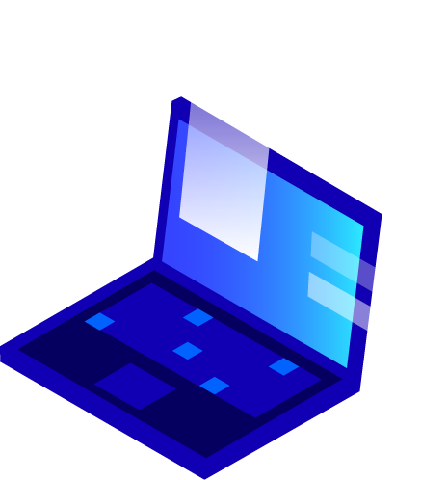


Sign Gloves IoT and 3D Intelligent System Project Andrea Grandi Daniele Vellani Luca Montagnani

Slide 2
Index
1. Project presentation
1.1. Problem
1.2. Features
1.3. Structure
2. Cloud and Communications
2.1. Web Application
2.2. Mobile Application
3. Machine Learning
3.1. Motivation
3.2. Model
3.3. Possible Improvements

Slide 3
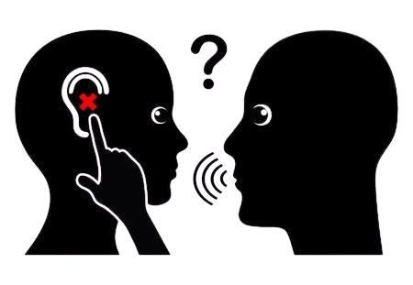
1.1 Problem
In Italy, the Deaf community that uses Italian Sign Language (LIS) comprises approximately 40,000 people
Source: Università Ca’ Foscari Venezia
Speech is the easiest way for communication in the world.
It becomes difficult for speech-impaired people to communicate with other people as they use sign language for communication.
When a speech-impaired person communicates with non-deaf person, the bridge gap between them is too much to fill . . .

Slide 4
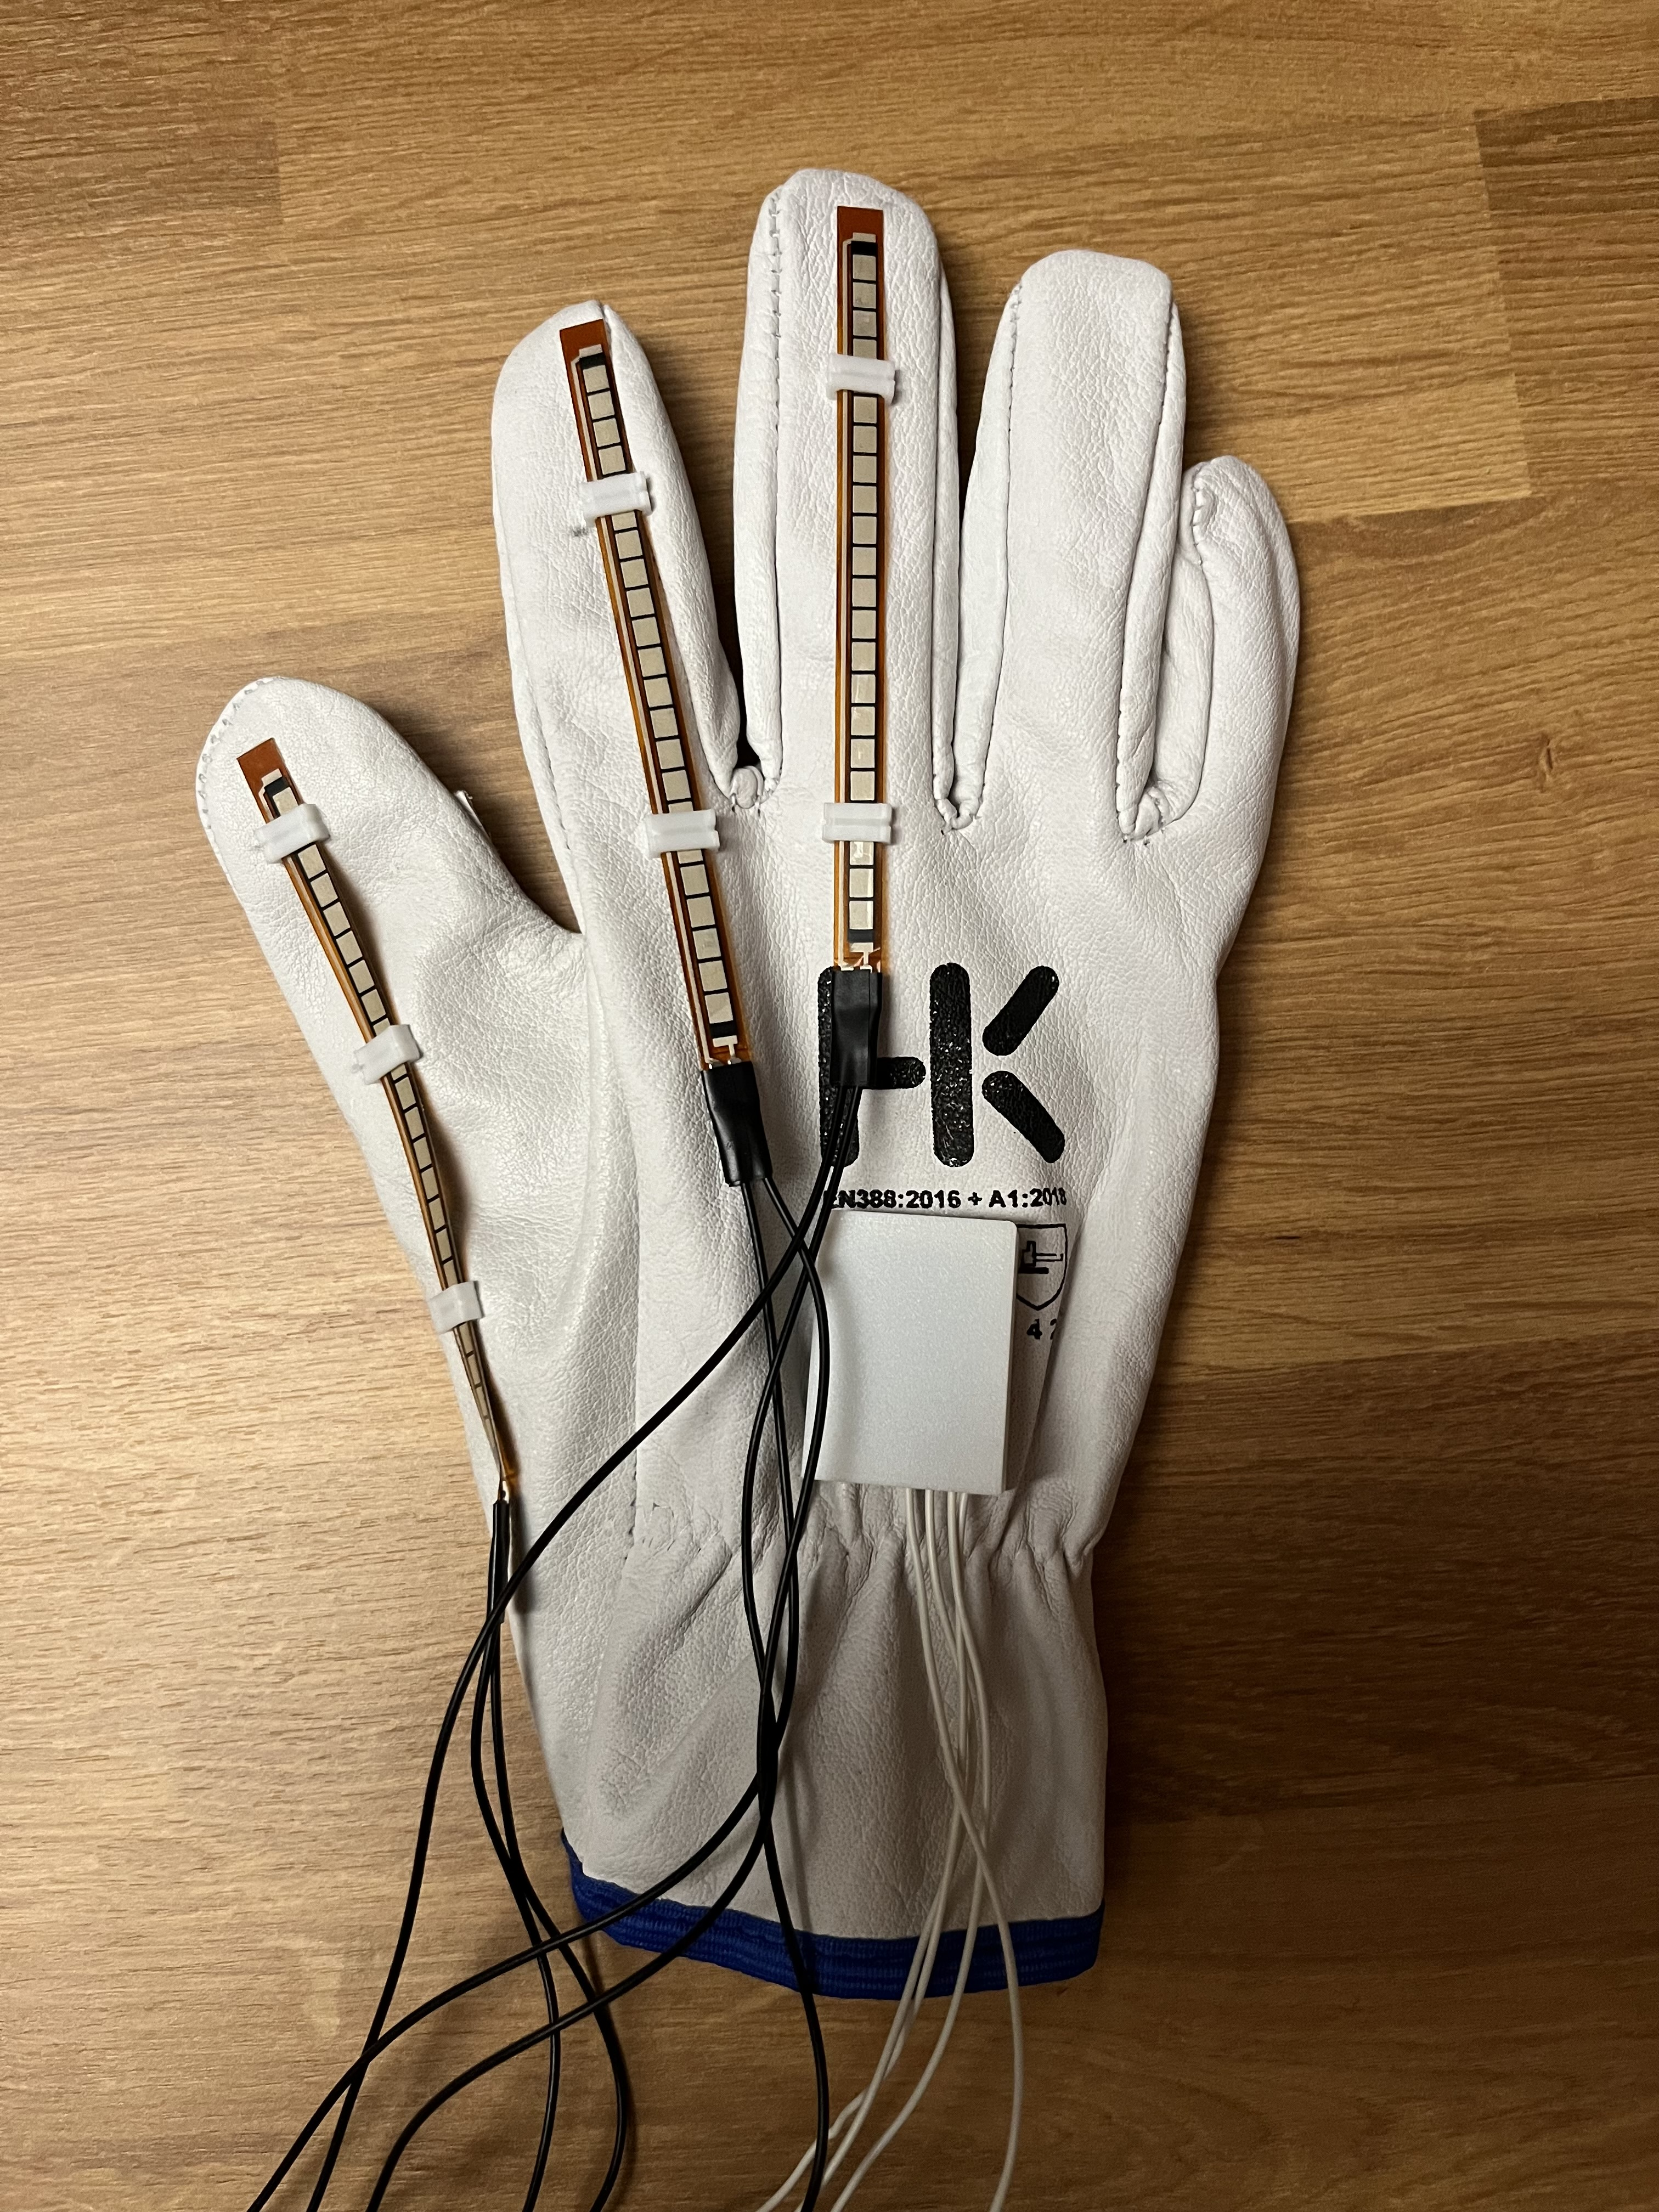
Solution
Sign Glove is capable of addressing this issue by facilitating communication between deaf and mute individuals with those who are not.

Slide 5
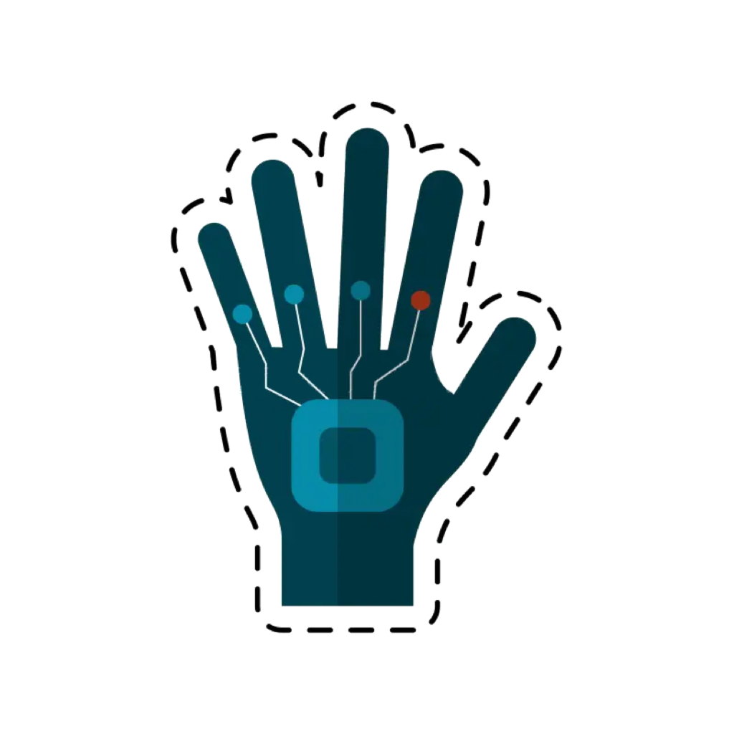
1.2 Features
Convert sign language in audio
Comunicate with other gloves through cloud
Detecting potentially hazardous situations

Slide 6
Roadmap
Idea
Glove Design
Glove Creation
1
3
5
2
4
6
Software Design
Implementation
Testing

Slide 7
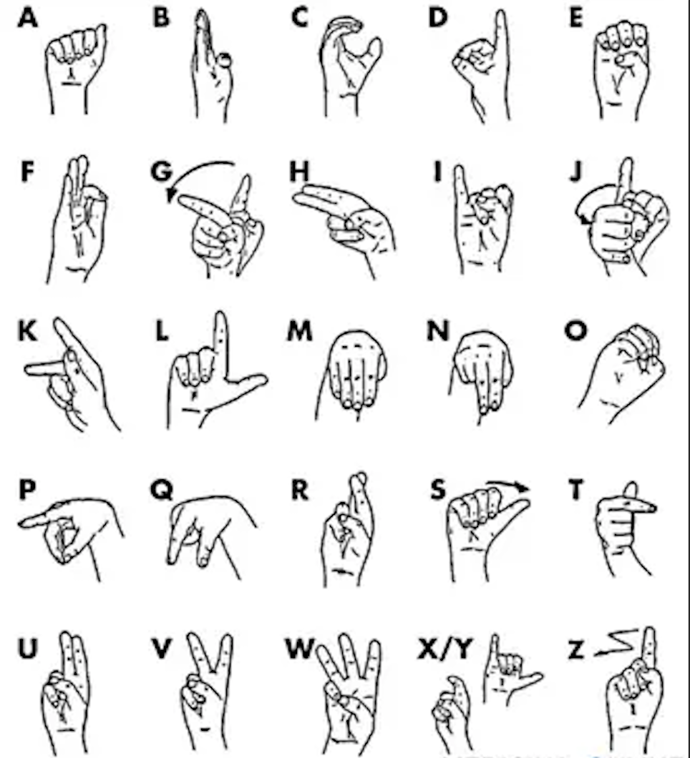
LIS Sign Language

Slide 8





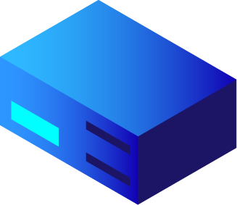



1.3 Structure
Controller: Arduino/Esp32 – C++
Android App: MIT App Inventor
Web App: Flask – Python
Predictions: Prophet
Comunications: MQTT/HTTP
Database: CouchDB

Slide 9
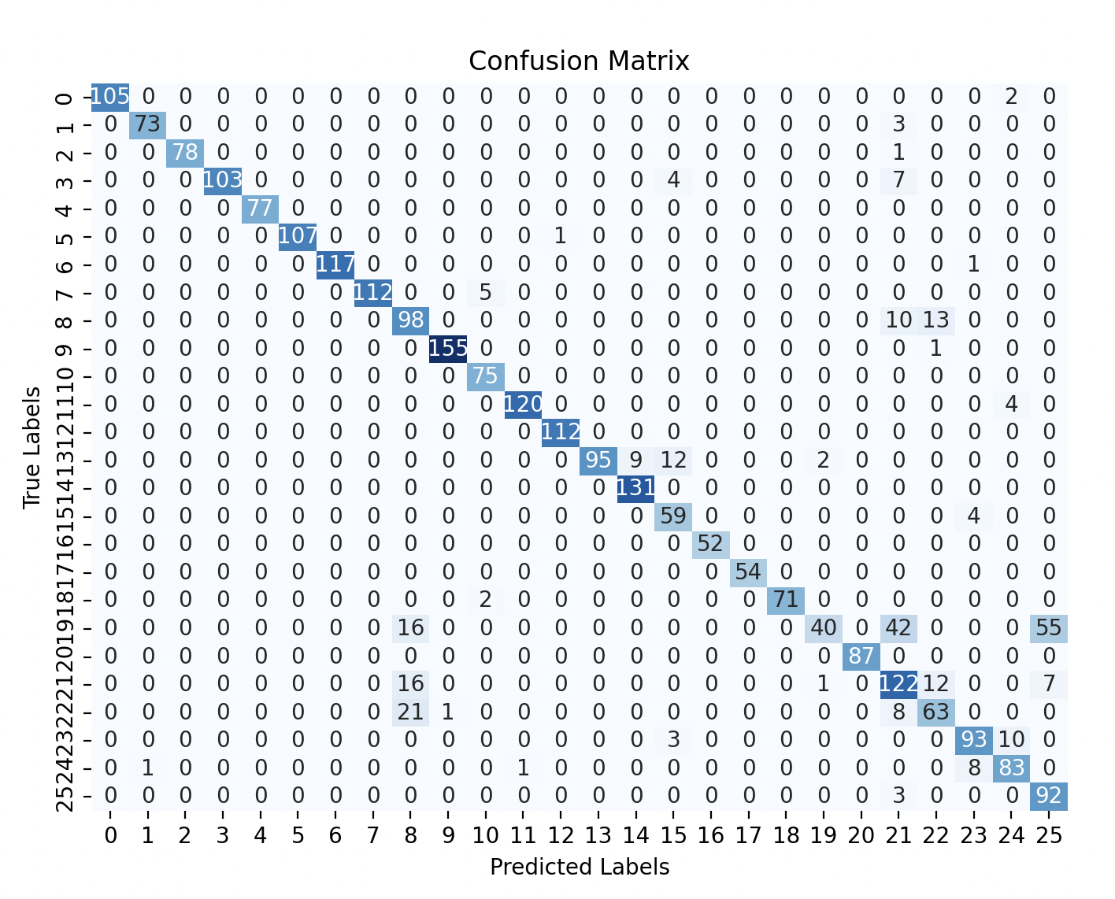
Results
Accuracy for translating hand position ≈ 0.9

Slide 10


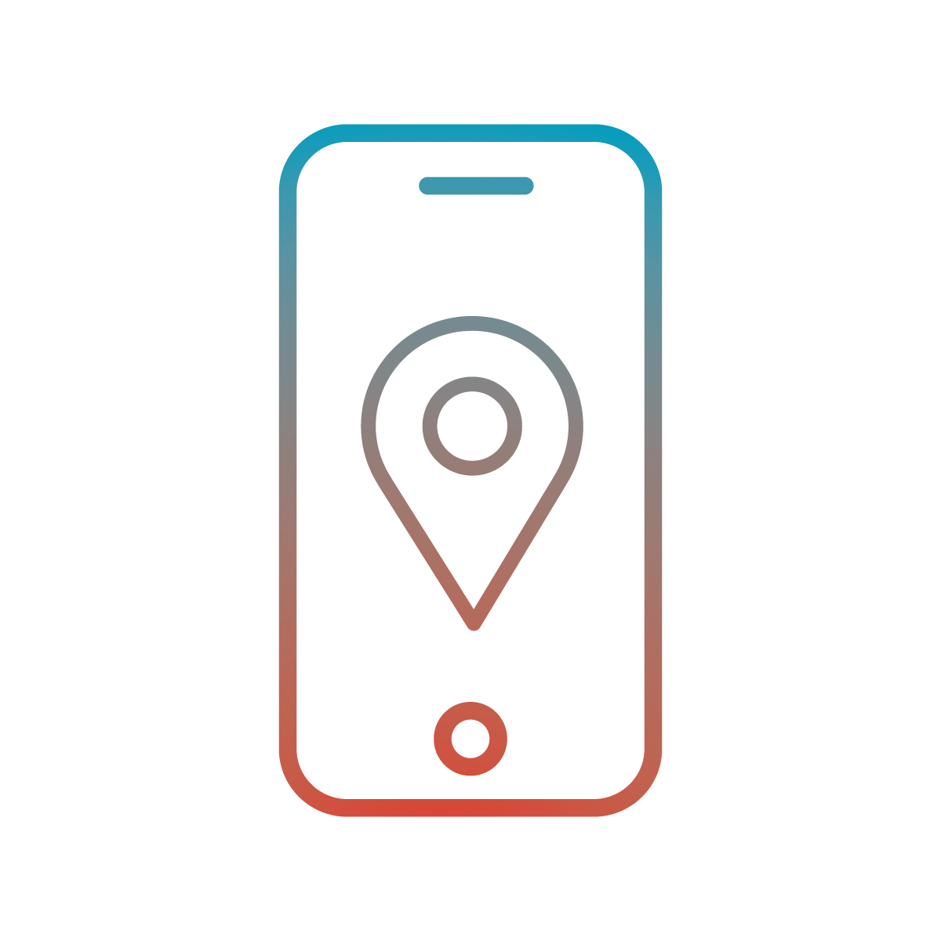
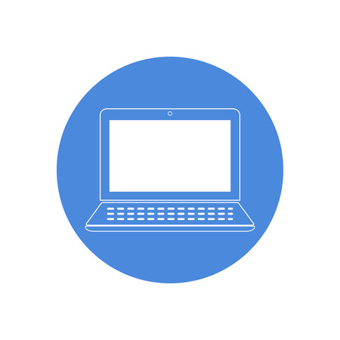

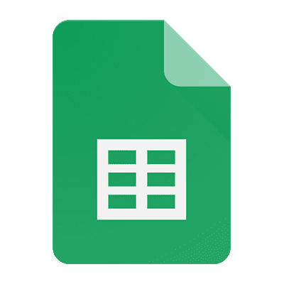


2 Cloud and communications
The communication between the devices occurs via MQTT and the use of a Database.
In particular, the implementation of a cloud solution and the mobile application aim to improve the safety and the accessibility of deaf people.
Mobile App
Web App
CouchDB
MQTT Broker
Mobile App
Google Sheets
Mobile App

Slide 11
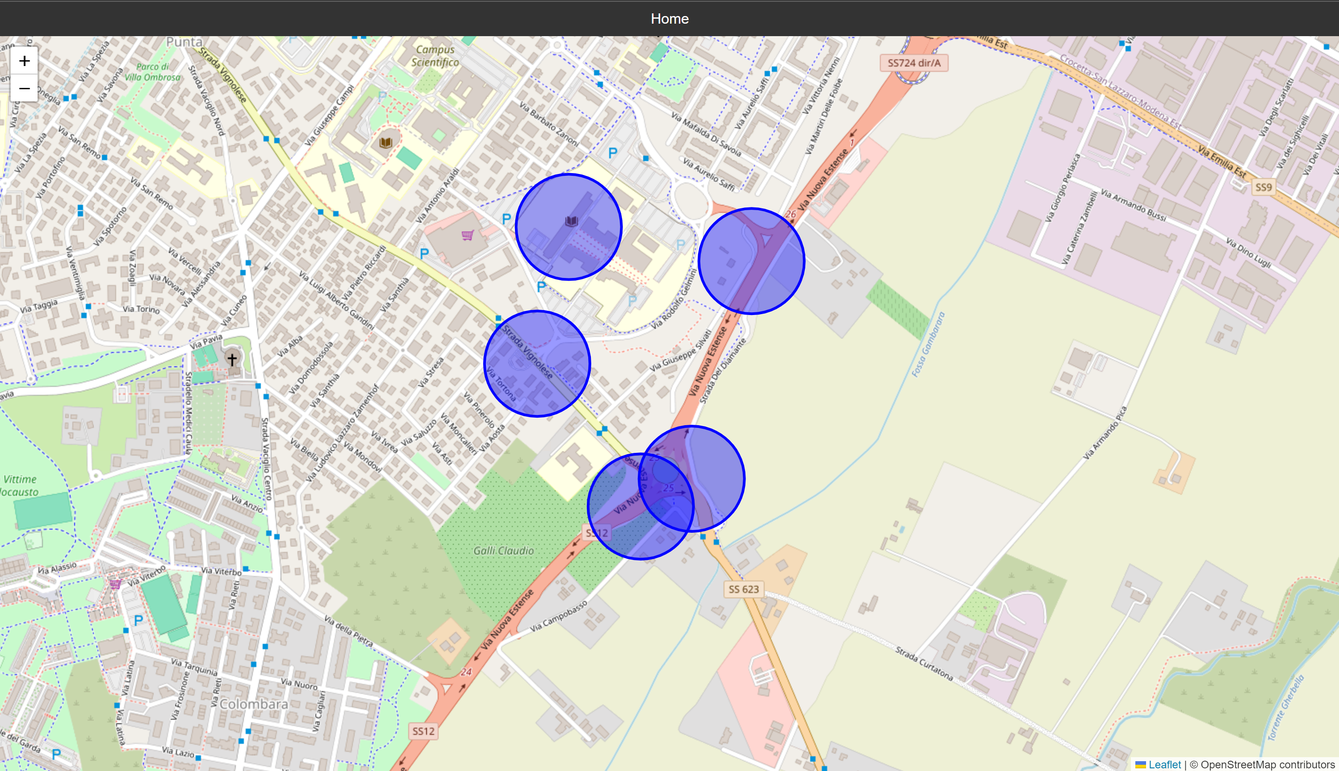
2.1 Web Application
The Web Application provides users with a general view of potentially hazardous areas.
Through the use of coordinates stored in the database, the app visualize dangerous zones on an interactive map.

Slide 12
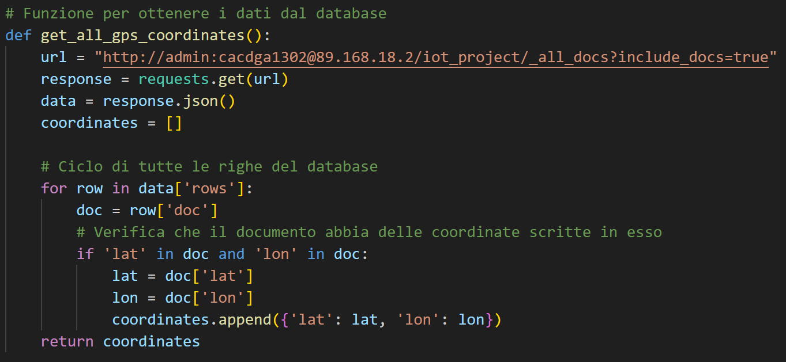
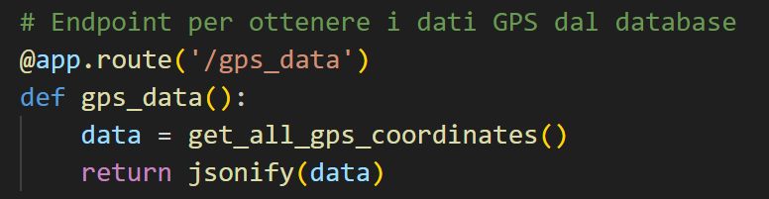
The app takes data from the database periodically, ensuring that the dangerous zones are always kept to date.
app.py

Slide 13
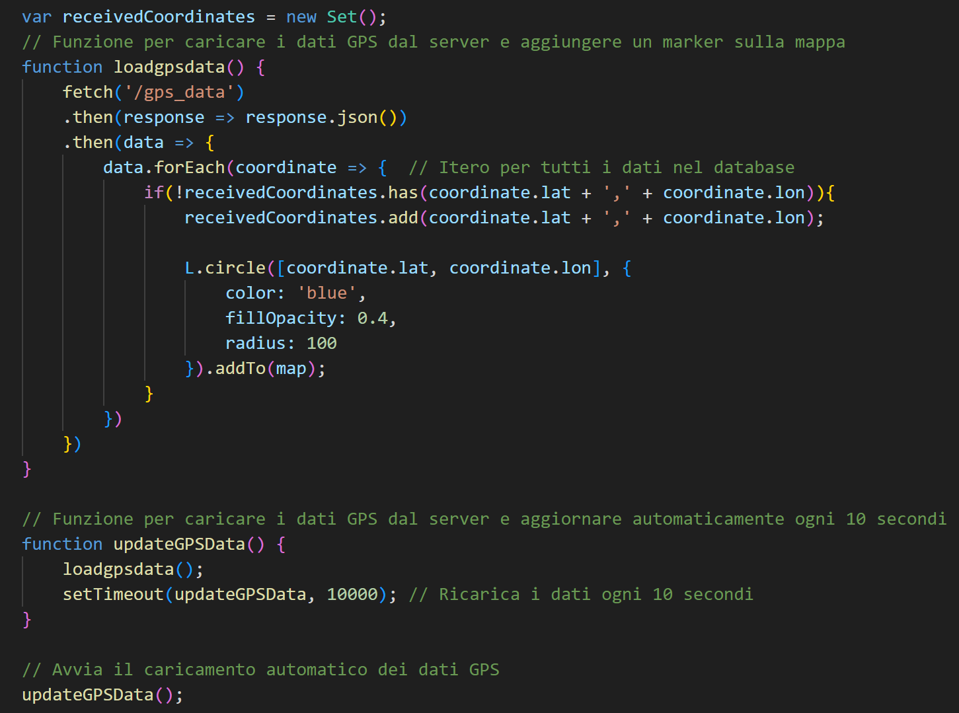
map.html

Slide 14
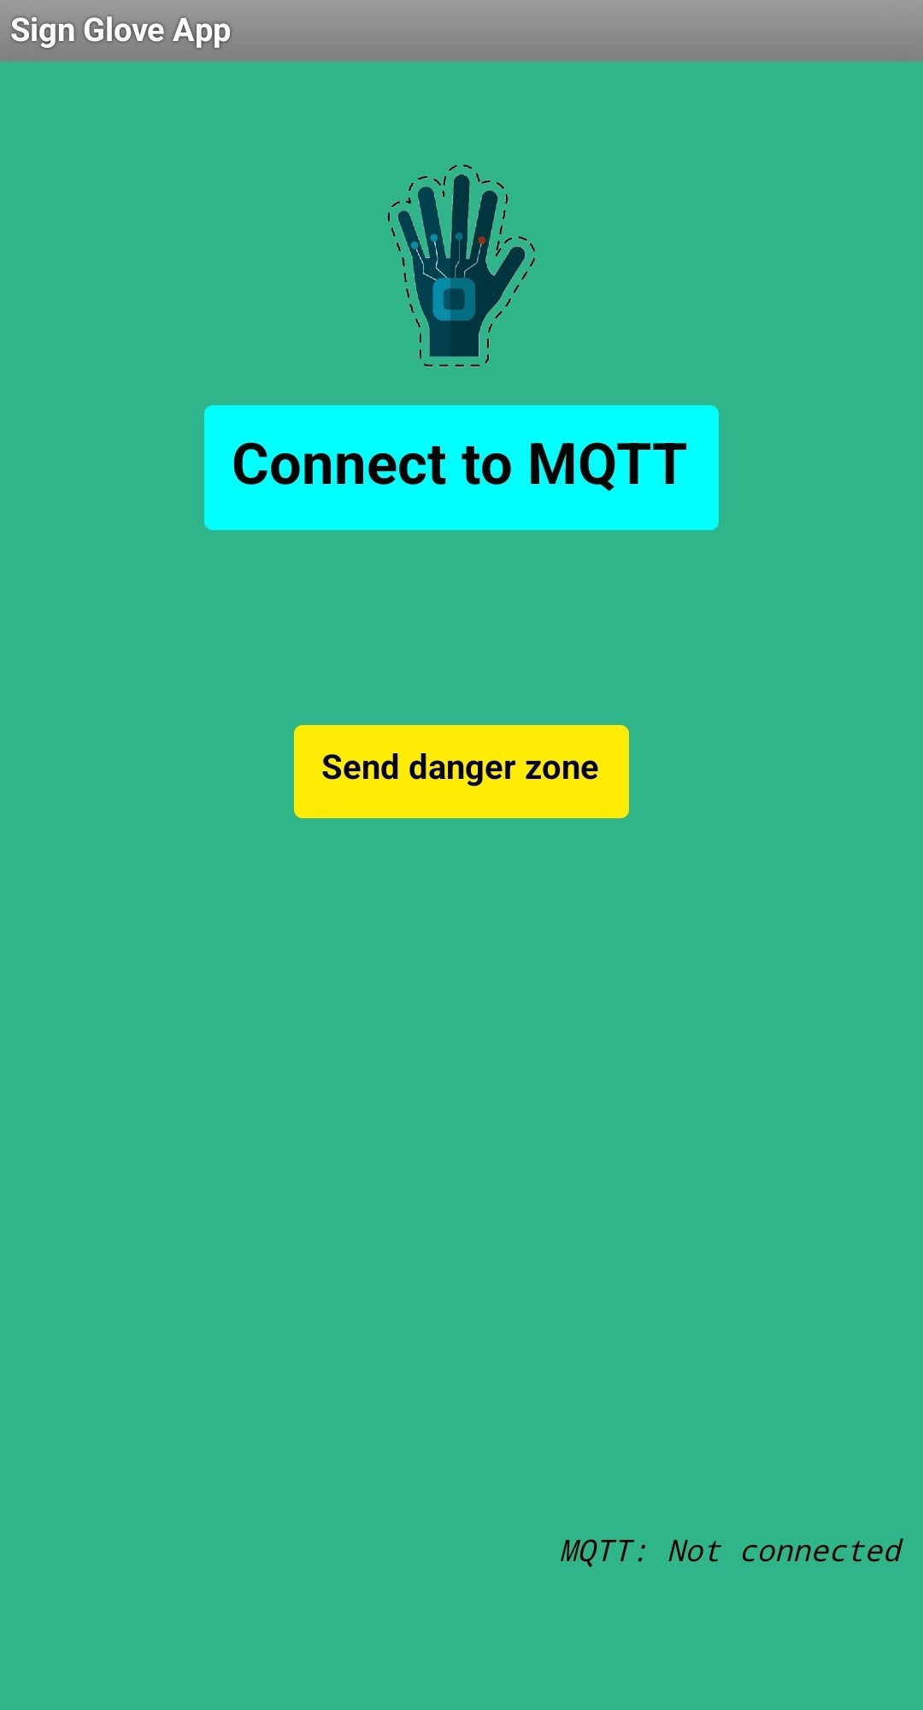
2.2 Mobile Application
Objective: Constantly monitor the user’s location and notify if entering a dangerous zone.
The Communication occurs via MQTT, where both the Broker and the devices work as both publishers and subscribers.
Also, it manages user credentials through the use of Google Sheets.

Slide 15
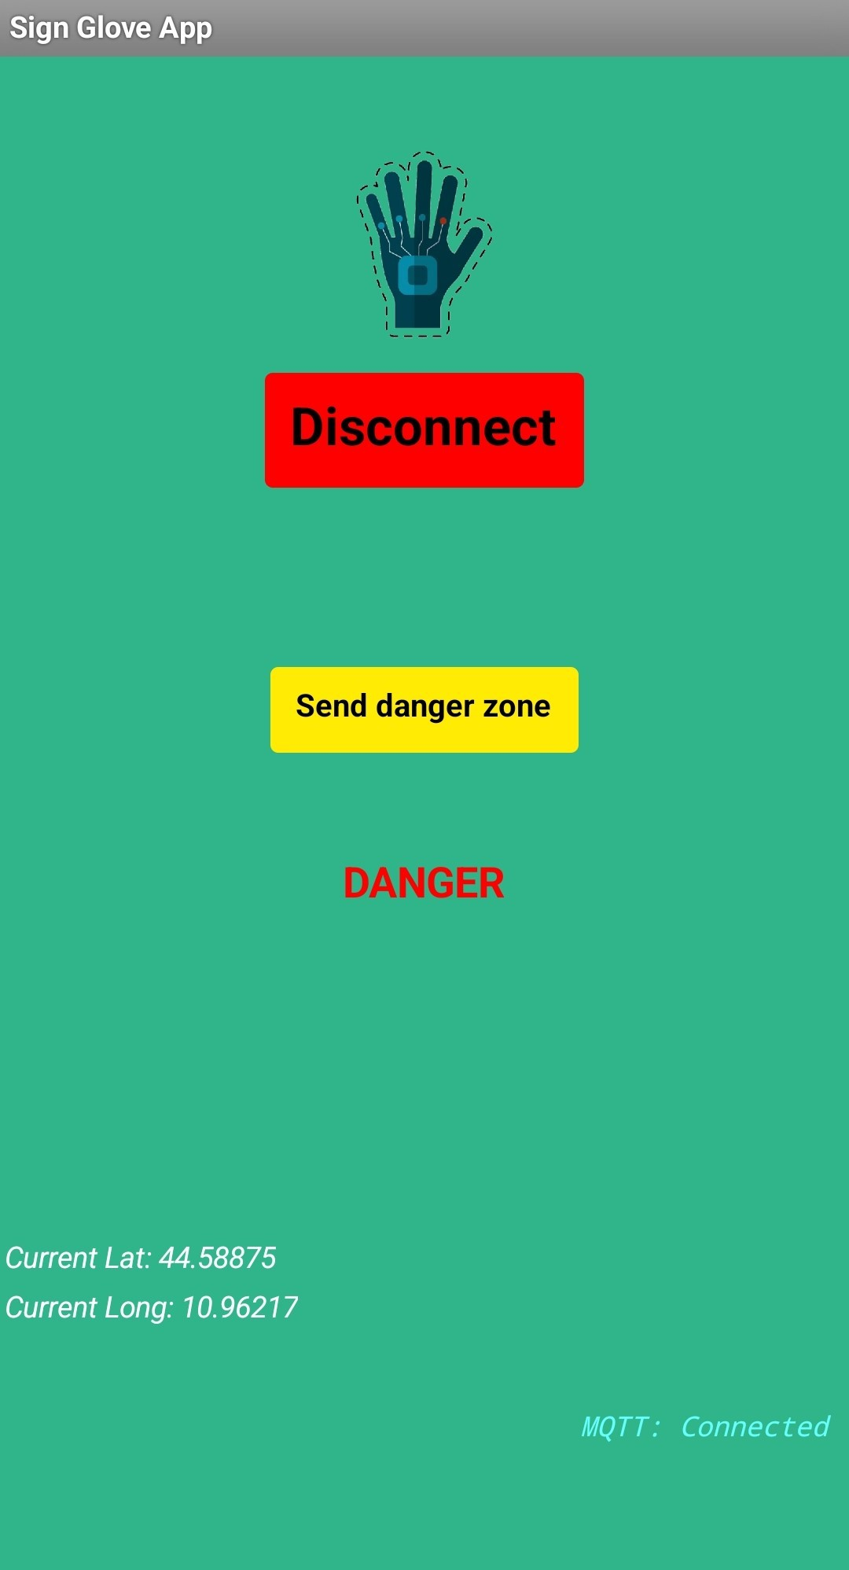
MQTT Communication:
The devices periodically send their current location to the MQTT Broker.
The MQTT Broker checks the received coordinates and sends a danger message if the user is in a hazardous zone.

Slide 16
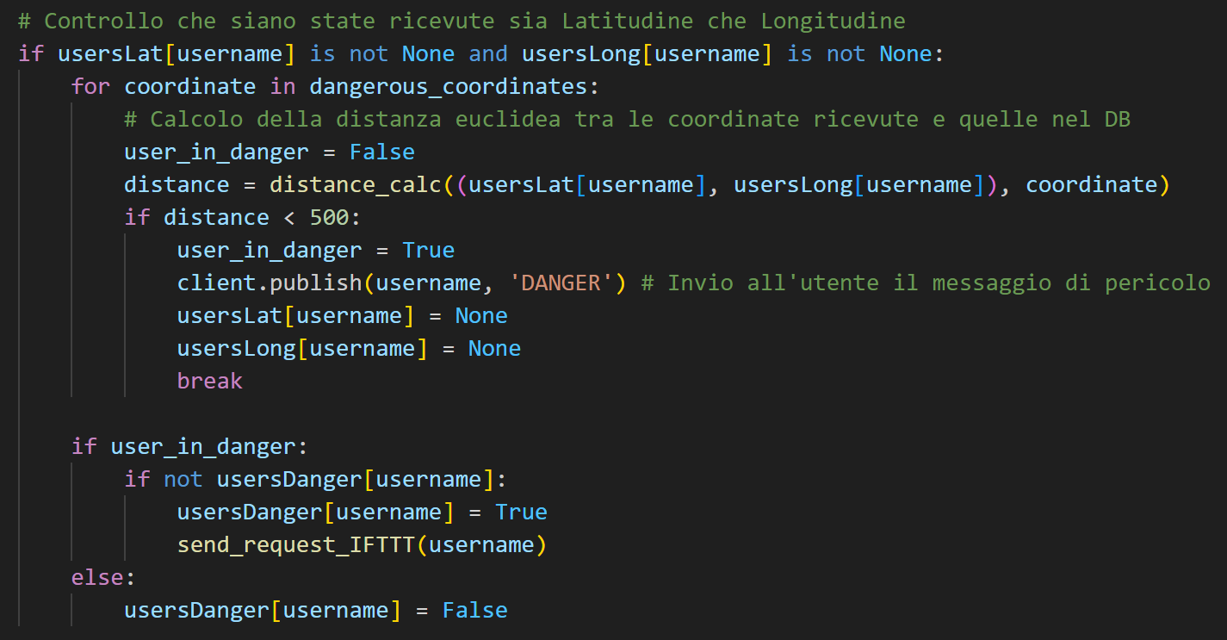
The MQTT Broker also sends a web request to IFTTT, which manages the notification system for the devices.

Slide 17
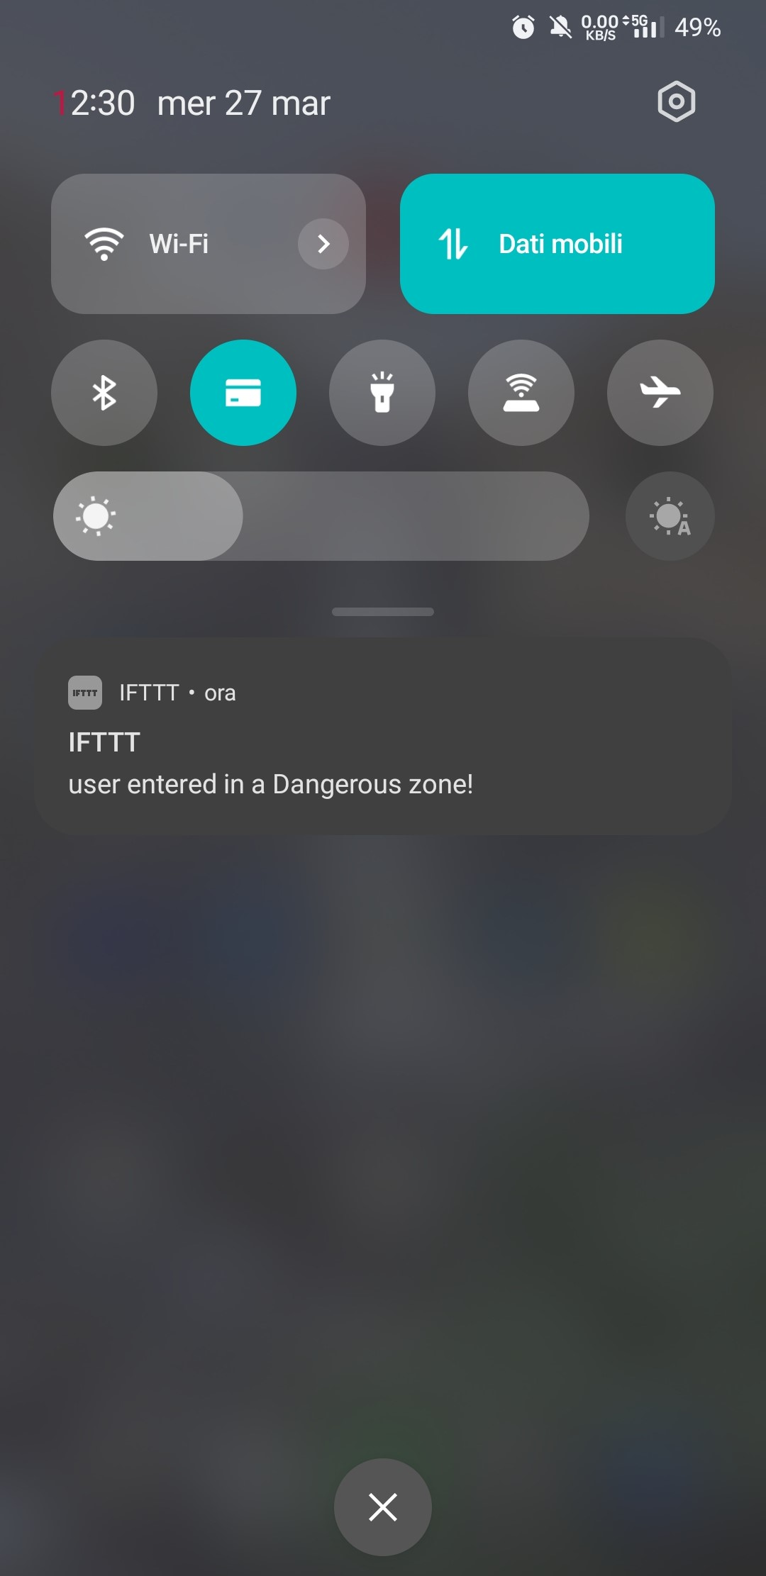
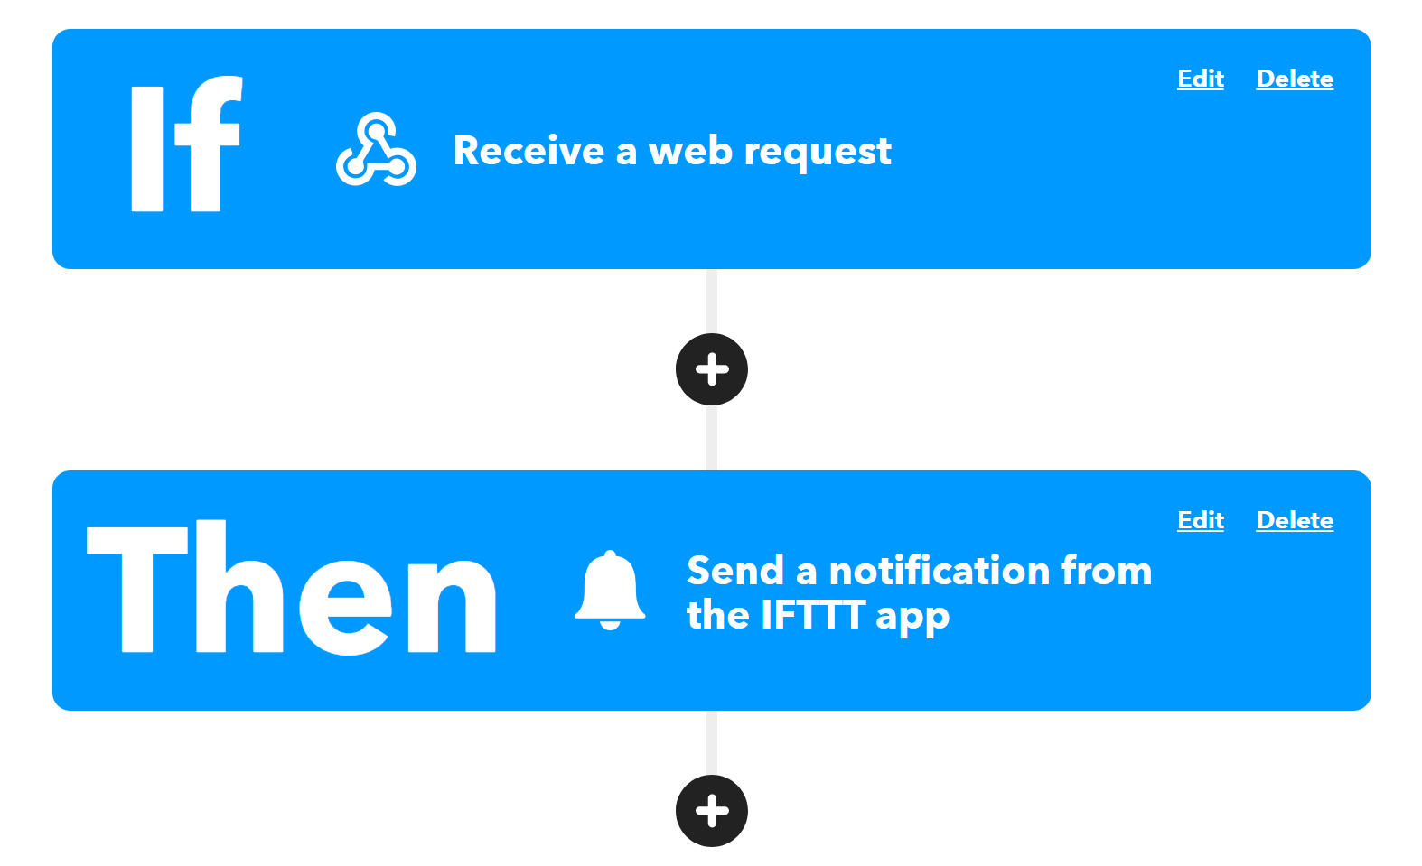
The MQTT Broker also sends a web request to IFTTT, which manages the notification system for the devices.

Slide 18
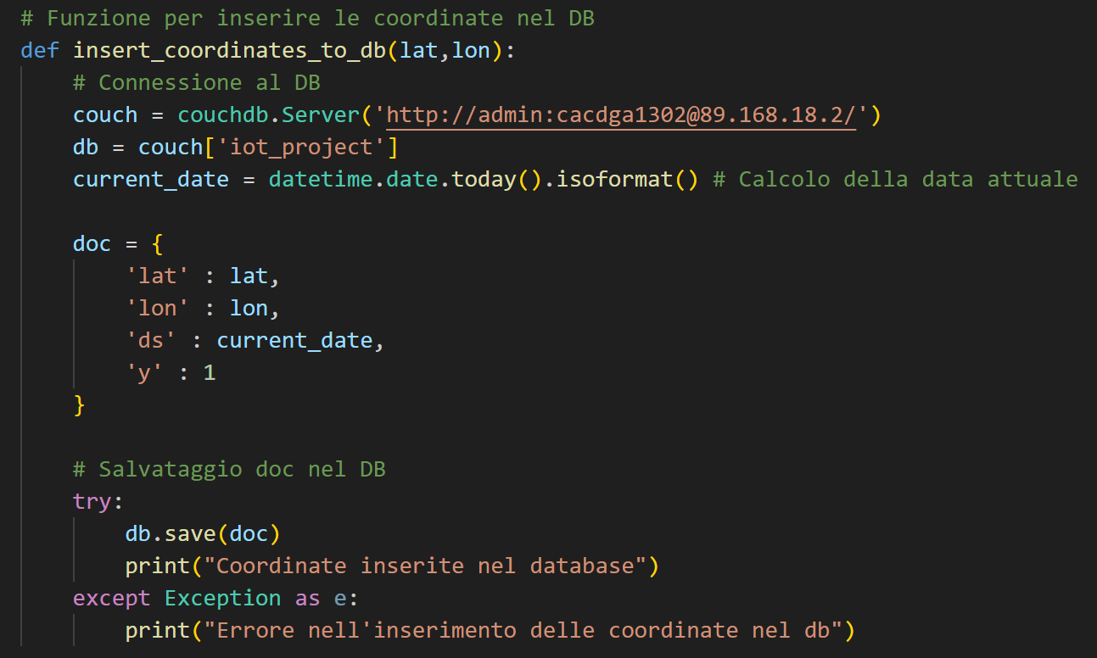
Another feature is the possibility to send a new dangerous location to the MQTT Broker, to be added to the CouchDB database.

Slide 19
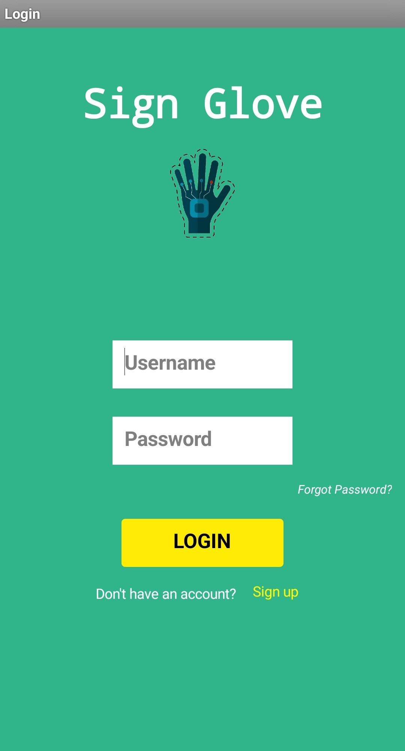
Credential management:
The App enables security and a controlled access, ensured by credential management, through the use of Google Sheets.

Slide 20
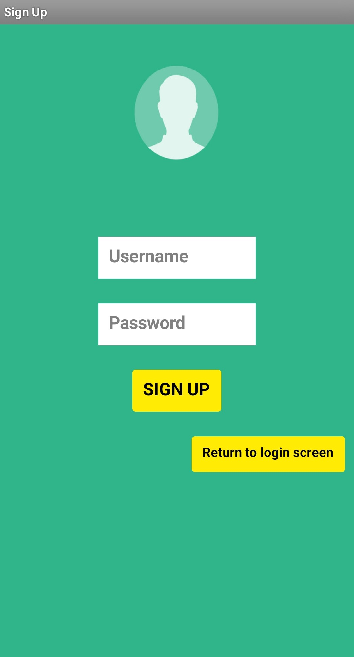
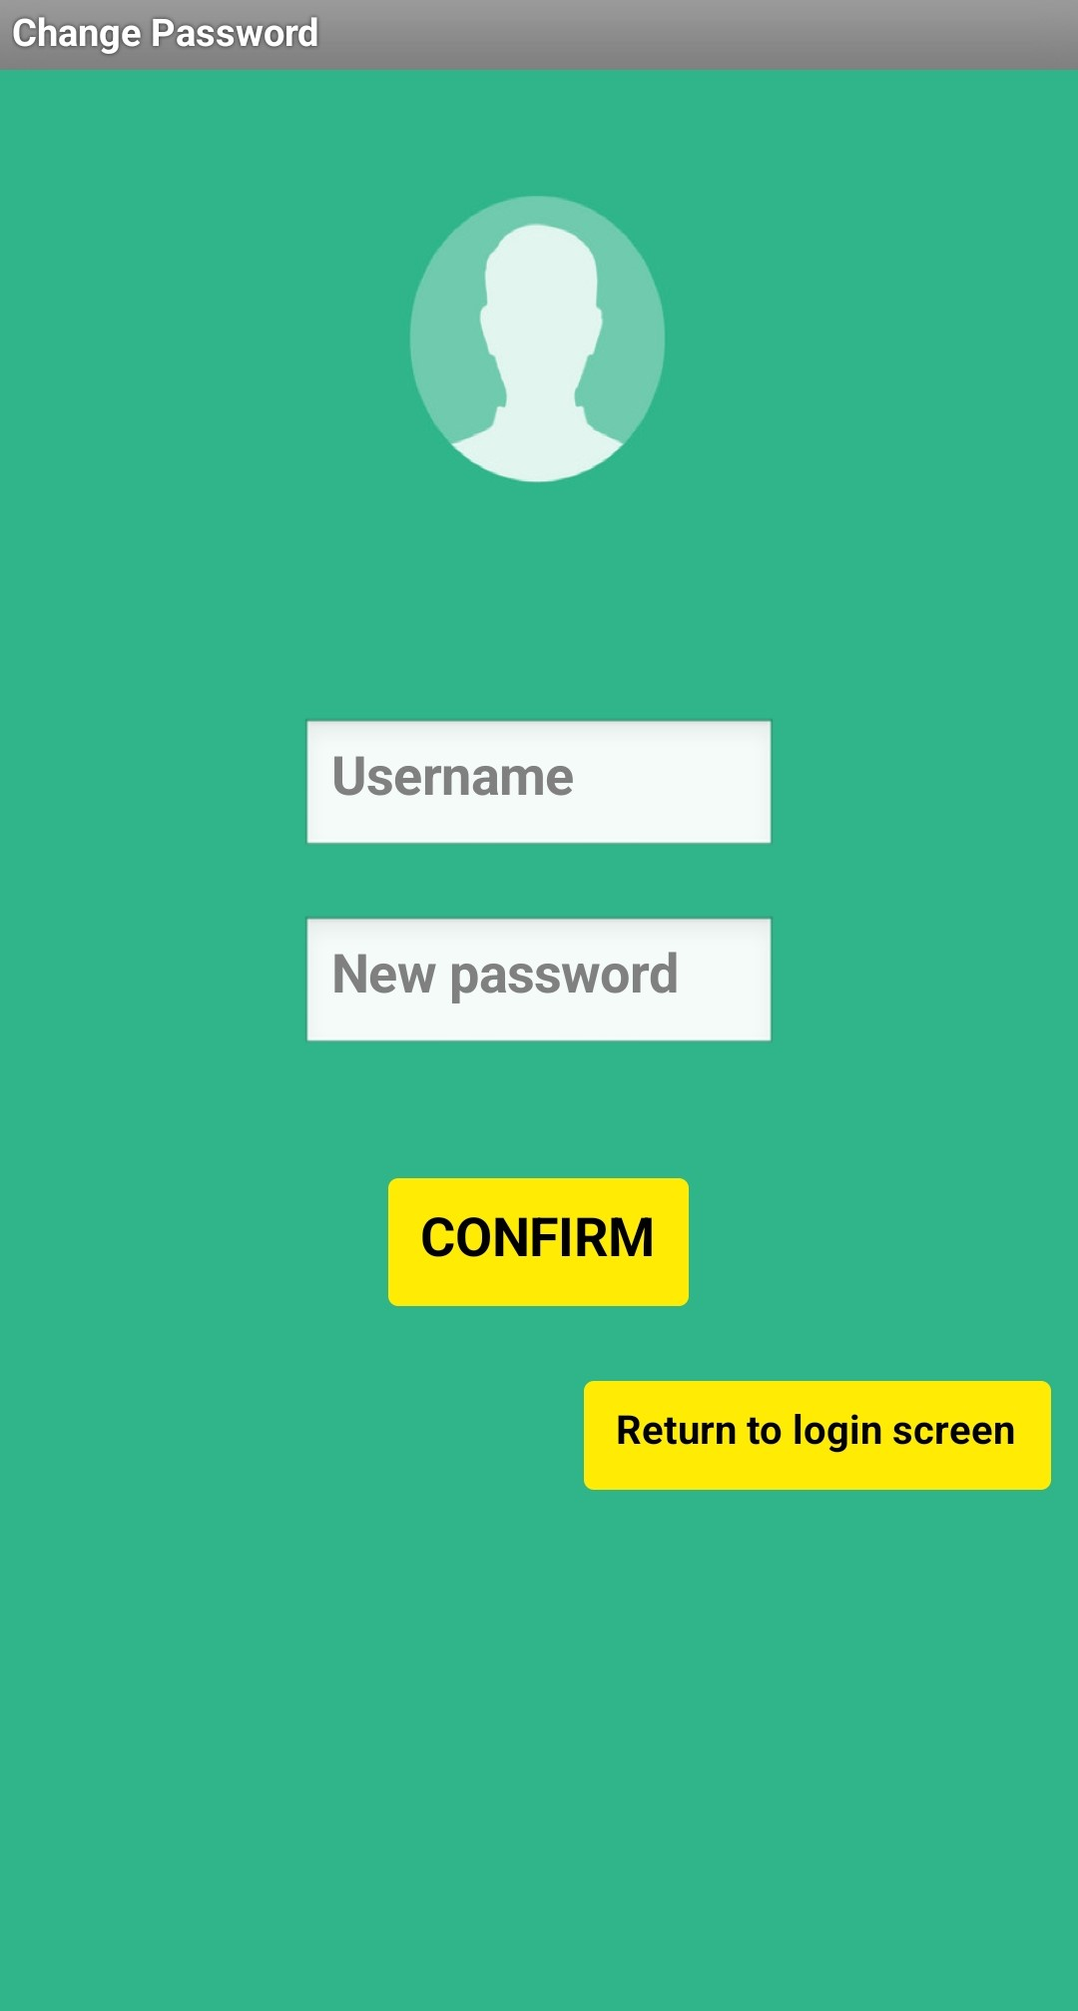

Slide 21
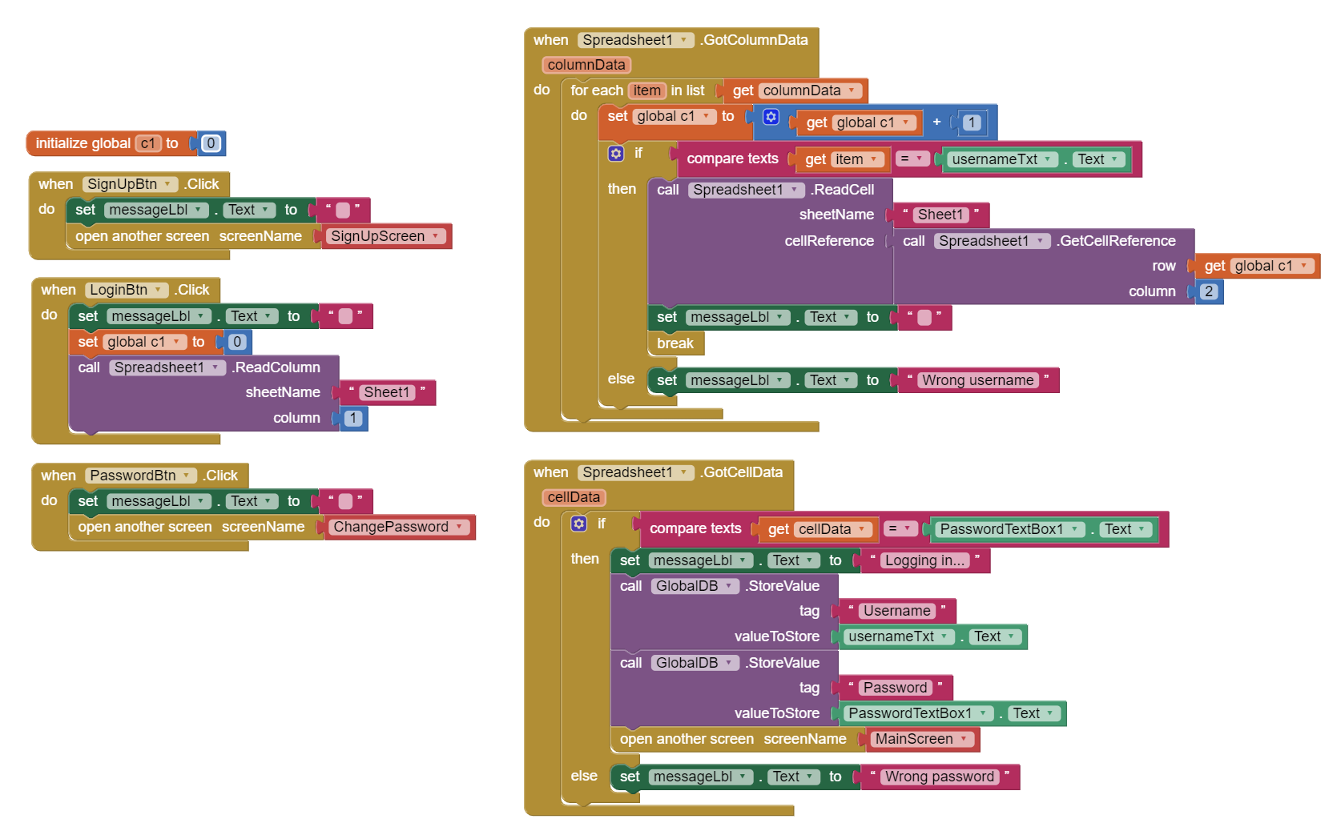
The entire Mobile Application was developed using MIT App Inventor:
Login Screen:

Slide 22
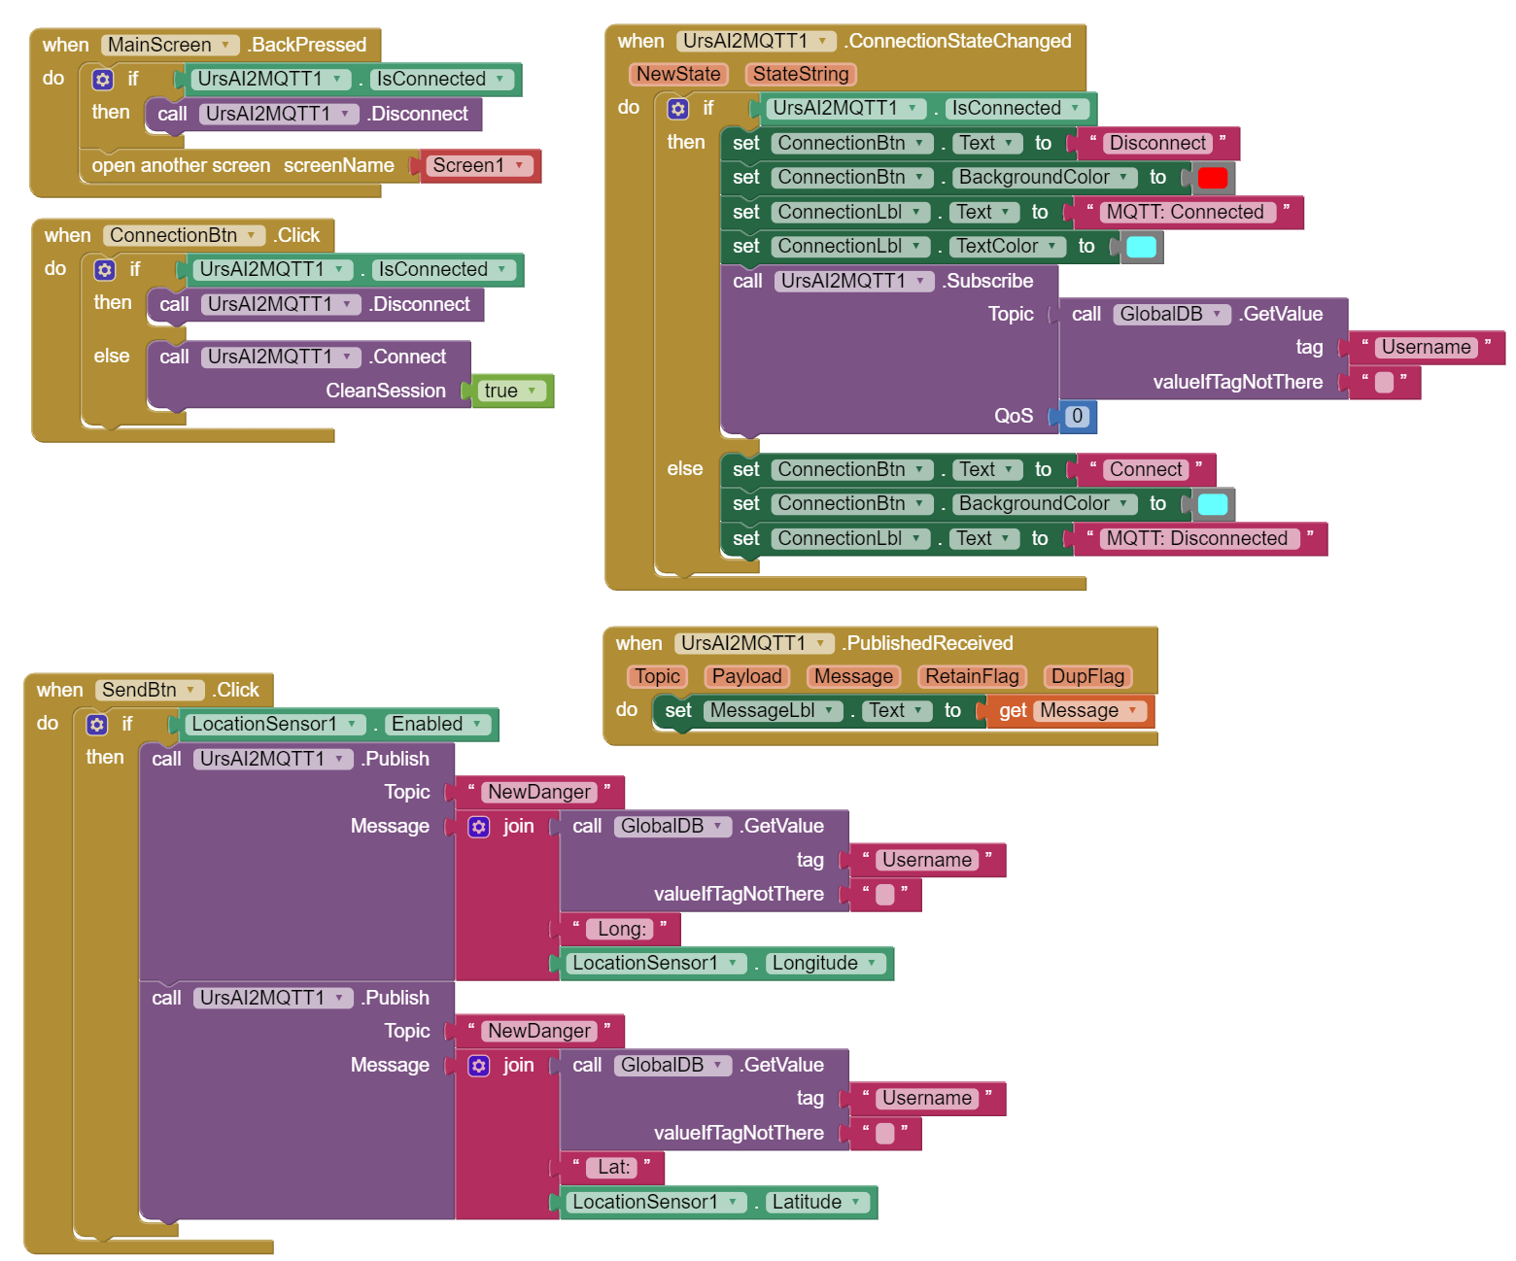
Main Screen (1):

Slide 23
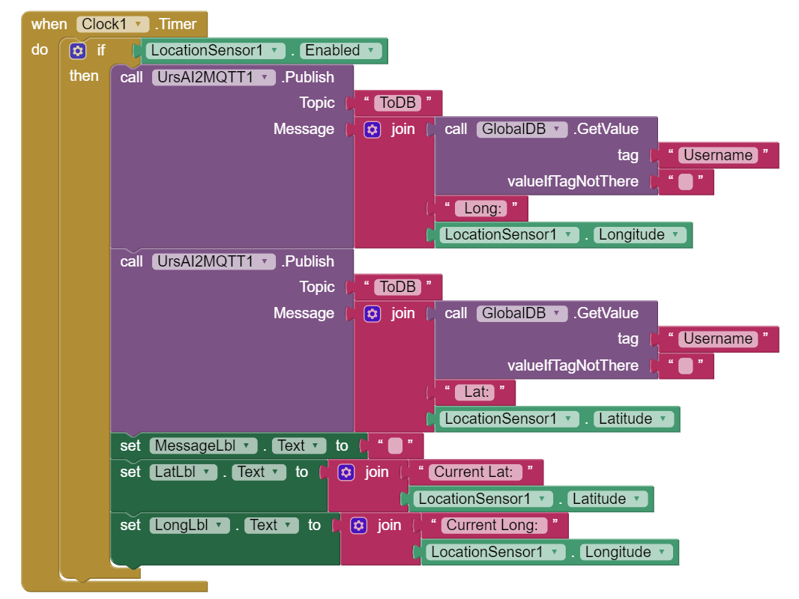
Main Screen (2):

Slide 24
3. Why do we need a warning prediction system?

Slide 25
3.1 Being voiceless it’s not that easy
Being deaf or mute can cause a lot of problems in modern life:
Isolated areas or with poor lighting
Areas with busy traffic or intersections
Events, construction sites, all places with loud sounds

Slide 26

3.2 Model
Using Prophet on time series, we can predict potential dangerous zones in Modena, by predicting the number of warning in a certain area.

Slide 27
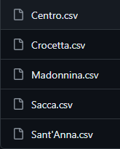
Dividing Modena in different neigborhoods, and training the model on all of them.

Slide 28
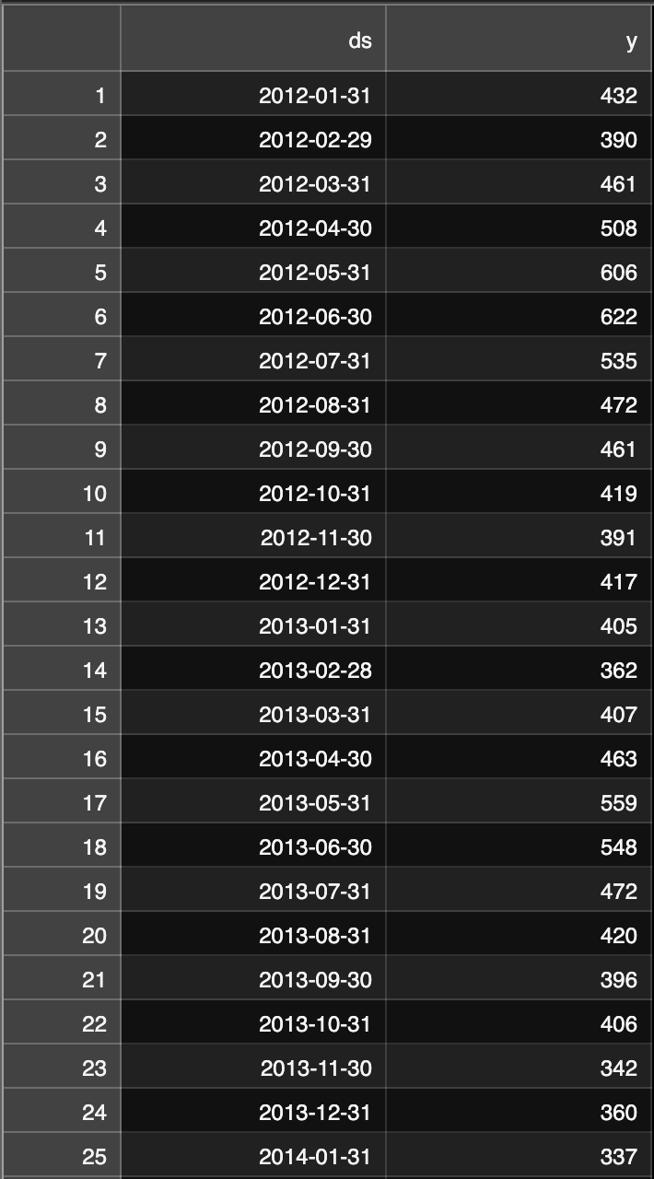
The database has 2 columns of interest, y and ds:
y: number of warnings
ds: the datetime

Slide 29
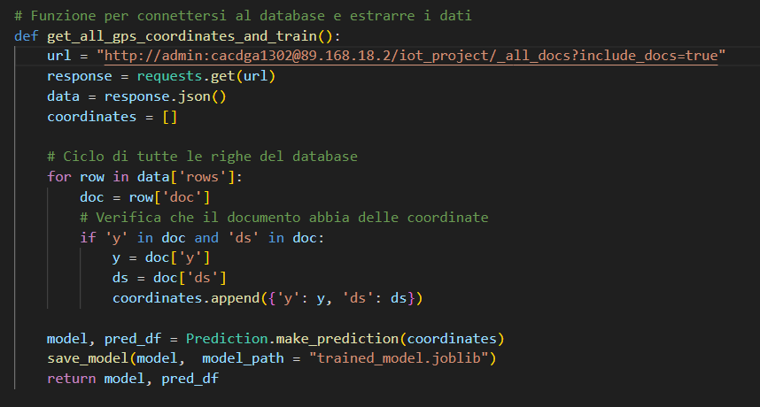
We train the model also on his predictions
And we do it monthly

Slide 30
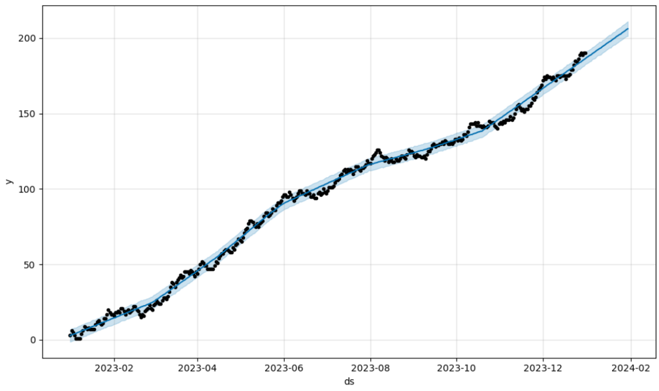
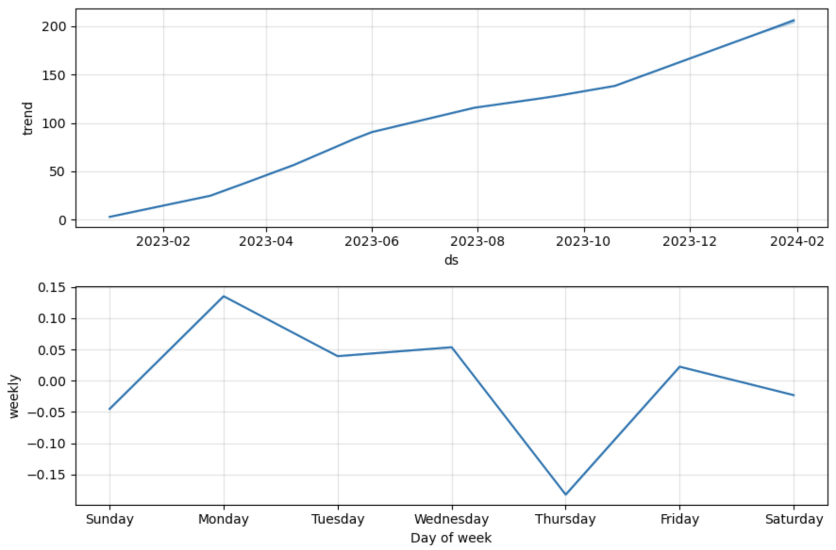
Points: real numbers
Blue line: the predicted trend

Slide 31
3.3 Possible improvements
In our society it’s a major problem to include minorities and promote equality.
Our project main goal it’s to work on that.
But there are a lot of improvements that can be made

Slide 32
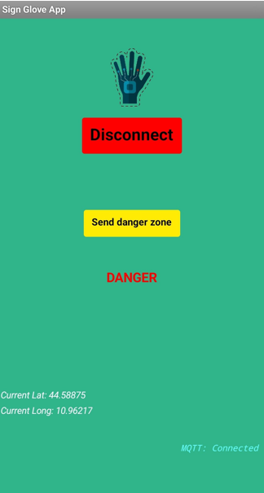
For example…
To help the accuracy of our prediction system, we added a button in the client app which everyone can use to set their location as dangerous, adding it to the database.

Slide 33
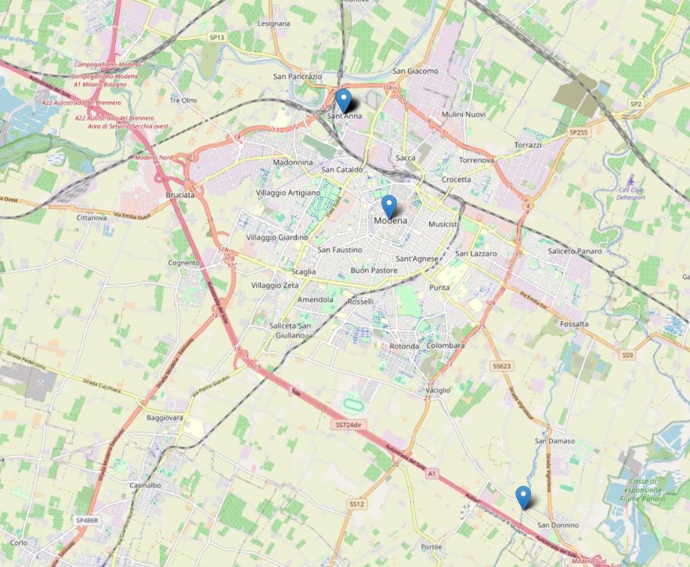
All dangerous zones can be shown in the web app with pointers.

Slide 34
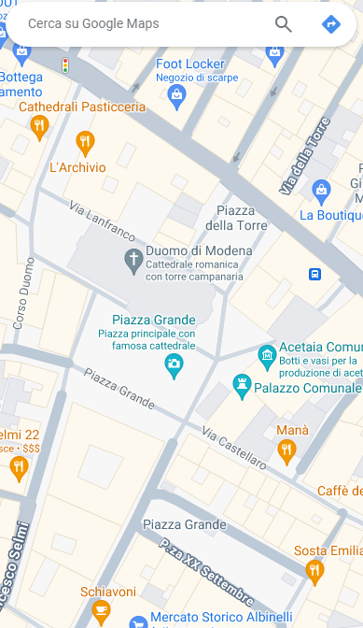
Or maybe, to help socialization, we can actually add a button that indicates for a limited time your position on the map, letting other people with the glove find you.
Ciao!

Slide 35
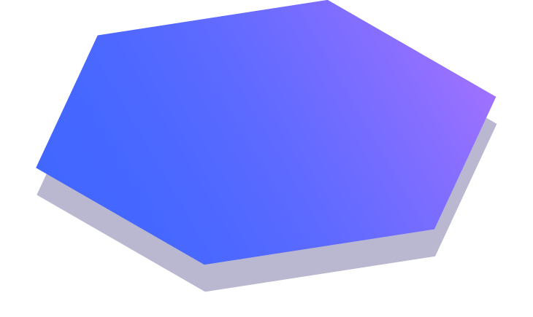
Thanks!

